Slide 1

Elevating Cinnamon Industry through Expert Guidance and Support
TMP-23-156

Slide 2


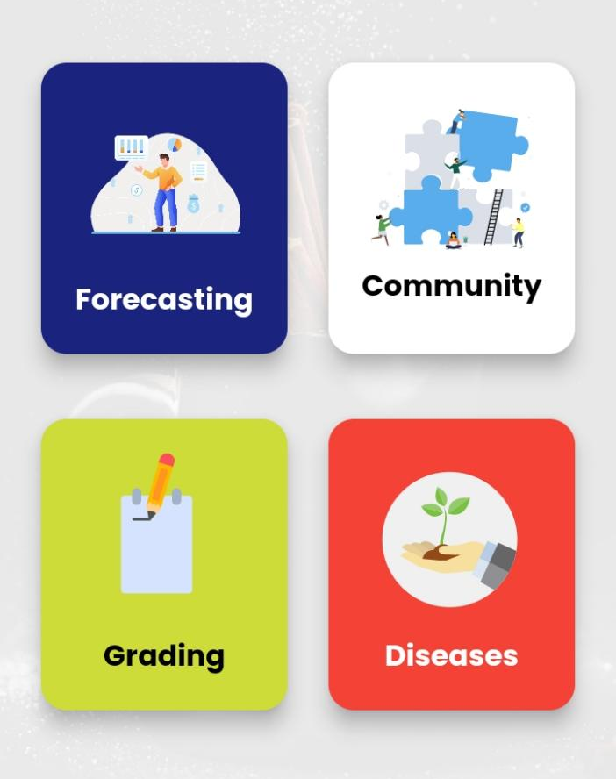
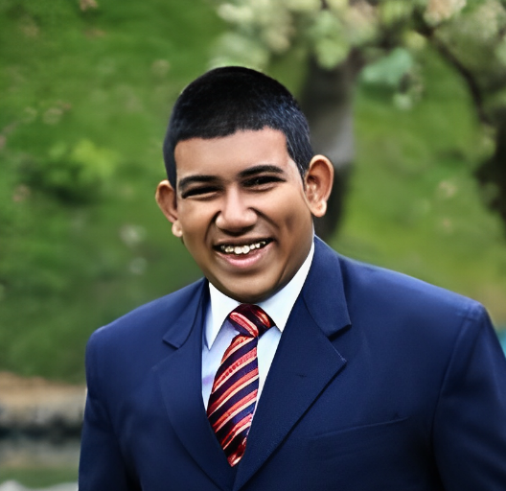
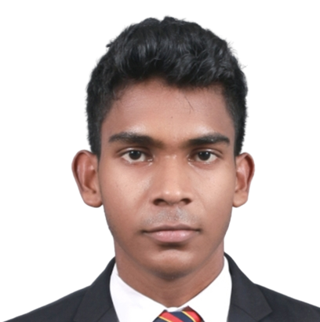
Meet the Team
Ravishan S.A.A.
IT20241032
Gamaethige G.G.S.A.
IT16026476
Ekanayaka E.M.A.I.B.
IT20252786
Edirisinghe B.M.
IT20252304

Slide 3

CINNAMON Price prediction.
Ravishan S.A.A.
IT20241032
IT20241032 | Ravishan S.A.A. | TMP-23-156

Slide 4



PROBLEM
IN CINNAMON INDUSTRY
Farmer
Collector
- Trader
Processor
Exporter
User
No Easy Way to find cinnamon prices
No Application to predict future prices
Hard to find location base prices
Cannot Imagine future cinnamon prices with the local economy situations
IT20241032 | Ravishan S.A.A. | TMP-23-156

Slide 5



SOLUTION
Need to know the Cinnamon Prices in Matara, next week
Analyze with the known data
Analyze with known wide range of information
User
Calculating themselves
Analyze with wide range of information with considering Special Factors using Deep Learning
Farmer
Collector
- Trader
Processor
Exporter
Ask from an expert
Use Agrox Application
IT20241032 | Ravishan S.A.A. | TMP-23-156

Slide 6
DATASET for Cinnamon Price
Source: Cinnamon Local Market Prices: https://exagri.info/mkt/index.html (Collected, Compiled and Published by the Economic Research Unit Department of Export Agriculture, LK)
FROM
Weekly Prices Available
Grades of Cinnamon Priced separately
Include the Prices base on the Location
TO
2016
January
05
Present
IT20241032 | Ravishan S.A.A. | TMP-23-156

Slide 7
Factors that are impact on Cinnamon Market Prices
INTERNAL
Y Axis
Prices of Foreign Markets
Local Prices
Demand
Cinnamon Exporting Companies
Supply
FOREIGN
Global Economy Status
LOCAL
X Axis
Local Economy Status
Currency Rate
Exchanging Currency
EXTERNAL
Y | Cinnamon Industry
X | People (Related to the Cinnamon Value Chain)
IT20241032 | Ravishan S.A.A. | TMP-23-156

Slide 8
Cinnamon Price Chart Comparison – LKR & USD
IT20241032 | Ravishan S.A.A. | TMP-23-156

Slide 9

Better Option for Price Prediction
$
Convert to USD
Price Prediction considering LKR | Price Prediction considering USD
Finance Dataset for currency conversion
Finance Dataset Source (for historical data & convert currency rates): https://www.federalreserve.gov/releases/h10/hist/dat00_sl.htm
IT20241032 | Ravishan S.A.A. | TMP-23-156

Slide 10

Technologies
Architecture:
Recurrent Neural Network (RNN)
Σ
Algorithm
ANN
LSTM
SVM
INPUT
Σ
OUTPUT
Σ
REQUIRED INPUTS :
Cinnamon Grade. Location. Date.
OUTPUTS:
PREDICTED PRICE (In USD & LKR)
INPUT
Σ
OUTPUT
IT20241032 | Ravishan S.A.A. | TMP-23-156

Slide 11
Technologies - Frameworks
Flask
Flexibility
Simplicity
Django
Convention
Framework
Batteries-included
Micro-framework
Full-featured framework
Lightweight
Small learning curve
Larger learning curve
Extensive feature set
IT20241032 | Ravishan S.A.A. | TMP-23-156

Slide 12
TECHNOLOGIES
• Programming Languages - Dart & Python
• Tools (IDE) - Android Studio Code and VS Code
• Web Server - AWS or MS Azure
• Database - MySQL
• Version Control - GitLab
IT20241032 | Ravishan S.A.A. | TMP-23-156

Slide 13
Over to Edirisinghe b.m.

Slide 14
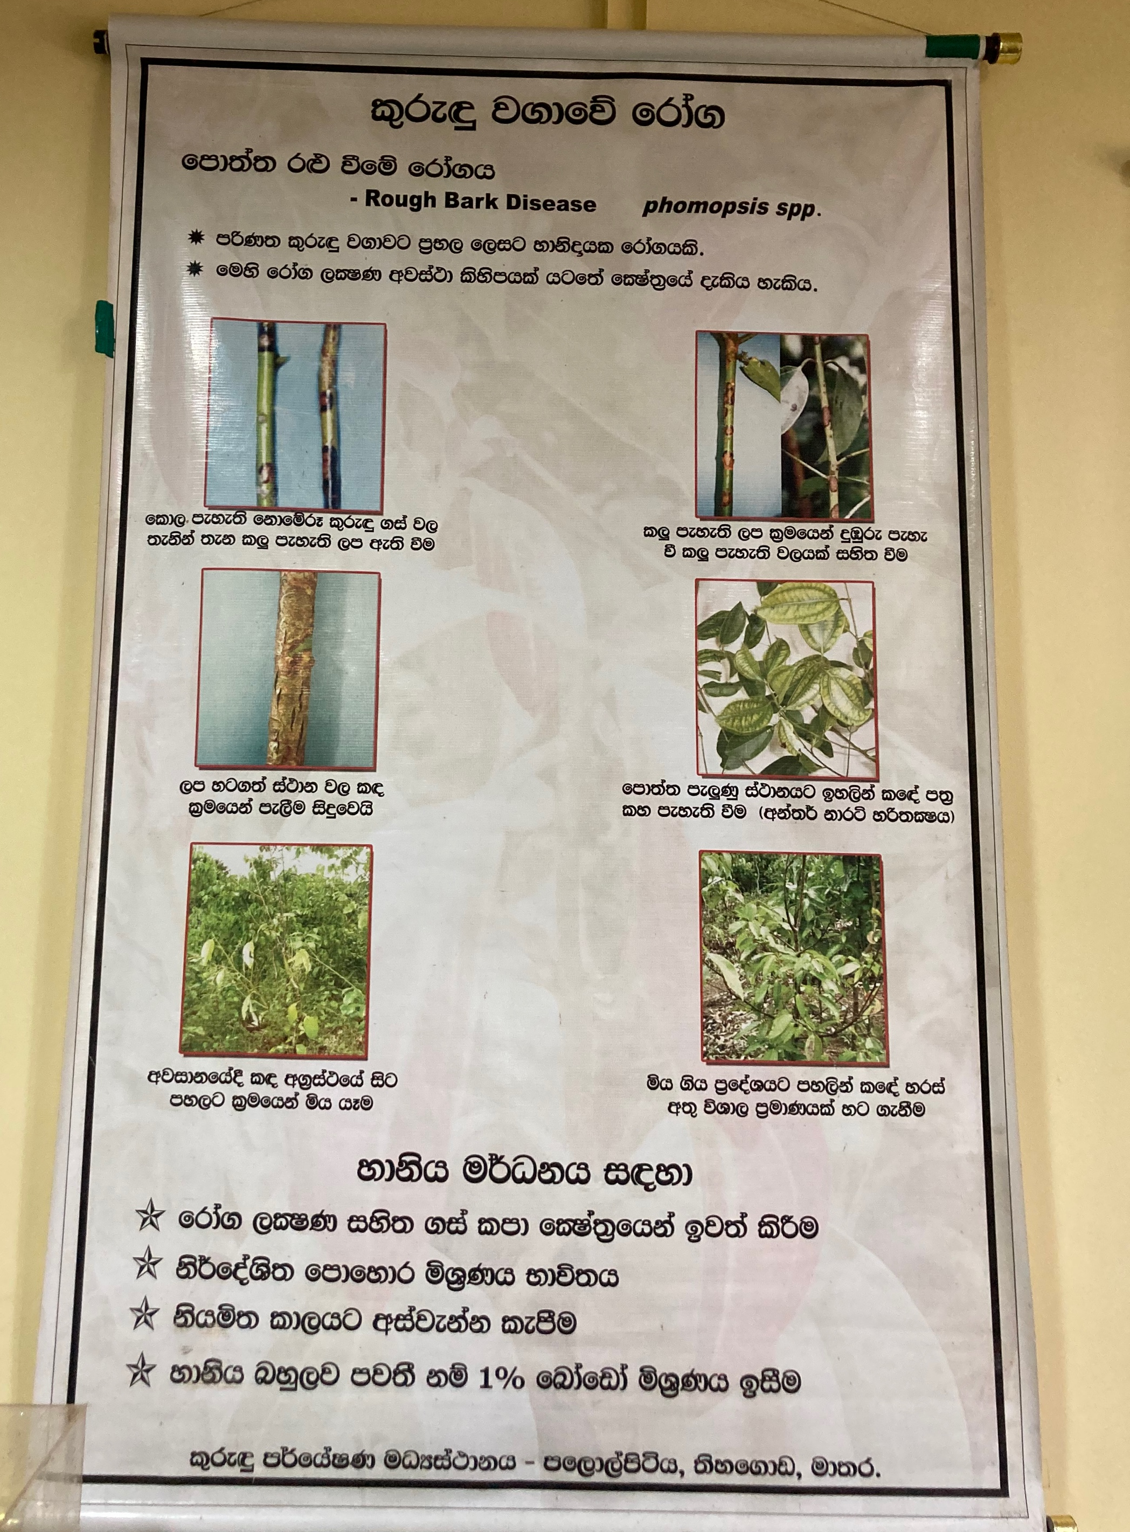
Rough bark disease (RBD) detection
Edirisinghe B.M.
IT20252304
IT20252304 | EDIRISINGHE B.M | TMP-23-156

Slide 15


Problem
? ?
? ? ?
? ?
Only experienced farmers can detect with the naked eye.
Newly appointed farmers must consult senior farmers.
Existing methods are not efficient.
Need a practical solution.
IT20252304 | EDIRISINGHE B.M | TMP-23-156

Slide 16



Options
Must know if this tree is infected with Rough Bark Disease (RBD).
Look carefully for symptoms: Takes too much time.
People who lack field experience must seek expert opinion: Takes too much time, a waste of labour.
User
Physically examine the tree
Anyone who has access to this application can accurately identify RBD
Consult an expert
Farmer
Nursery Manager
- Untrained Farmer
Use AGROX
IT20252304 | EDIRISINGHE B.M | TMP-23-156

Slide 17
Research Gaps
Existing related research
Research on RBD.
[1] D. L. C. Kumari Fonseka, H. N. Aluthgamage, and W. W. U. I. Wickramaarachchi, “Present situation of cinnamon industry in southern Sri Lanka,” International Journal of Current Research in Biosciences and Plant Biology, vol. 5, no. 8, pp. 63–70, 2018.
[2] “Cinnamon,” Cinnamon | Diseases and Pests, Description, Uses, Propagation. [Online]. Available: https://plantvillage.psu.edu/topics/cinnamon/infos. [Accessed: 05-Apr-2023].
[3] “Rough bark disease on cinnamon (cinnamomum zeylanicum): Disease ...” [Online]. Available: https://www.researchgate.net/publication/315380426_ROUGH_BARK_DISEASE_ON_CINNAMON_Cinnamomum_zeylanicum_DISEASE_SYMPTOMS_DEVELOPMENT_AND_THE_CAUSAL_AGENT_WITH_SPECIAL_REFERENCE_TO_ITS_MORPHOLOGY_HISTOPATHOLOGY_AND_NUTRITIONAL_STATUTES_OF_AFFECTED_PLAN. [Accessed: 05-Apr-2023].
Detecting diseases through image processing (Olive).
[4] Author links open overlay panelAditya Sinha a, a, b, and AbstractThe olive tree is a highly beneficial fruit tree with the earliest known history of its plantation going back to 6000 years. The production of olive oil is facing a significant threat nowadays due to climate change and the spread of diseases. In t, “Olive spot disease detection and classification using analysis of leaf image textures,” Procedia Computer Science, 16-Apr-2020. [Online]. Available: https://www.sciencedirect.com/science/article/pii/S1877050920307511. [Accessed: 05-Apr-2023].
Identifying RBD and its symptoms.
[5] Azad, R., Kumara, K.W., Senanayake, G., Ranawaka, R., Pushpakumara, D. and Geekiyanage, S., 2019. Intensity of leaf spot and rough bark diseases in cinnamon accessions collected from major cinnamon growing areas of Sri Lanka. Journal of the National Science Foundation of Sri Lanka, 47(3), pp.297–305. DOI: http://doi.org/10.4038/jnsfsr.v47i3.9403
Research Gap
Lack of research on technical approaches and solutions for Cinnamon RBD.
Our Research
Implements a mobile application that can detect RBD using computer vision.
Provide solutions for the RBD through the system.
Optimized system to respond accurately to lower-quality images.
IT20252304 | EDIRISINGHE B.M | TMP-23-156

Slide 18
Solution
Accurate
Efficient
Easy to use
Simple and Minimal
Informative
IT20252304 | EDIRISINGHE B.M | TMP-23-156

Slide 19
OBJECTIVES
Collect image data
Find datasets
Label images
Preprocess Images
Capture
Image resizing
Image normalization
Training machine learning model
Pre-existing model (CNN) / Train model using TensorFlow or PyTorch
Integrate the model into the mobile application
Include a camera feature in the application
Test and improve the application
IT20252304 | EDIRISINGHE B.M | TMP-23-156

Slide 20
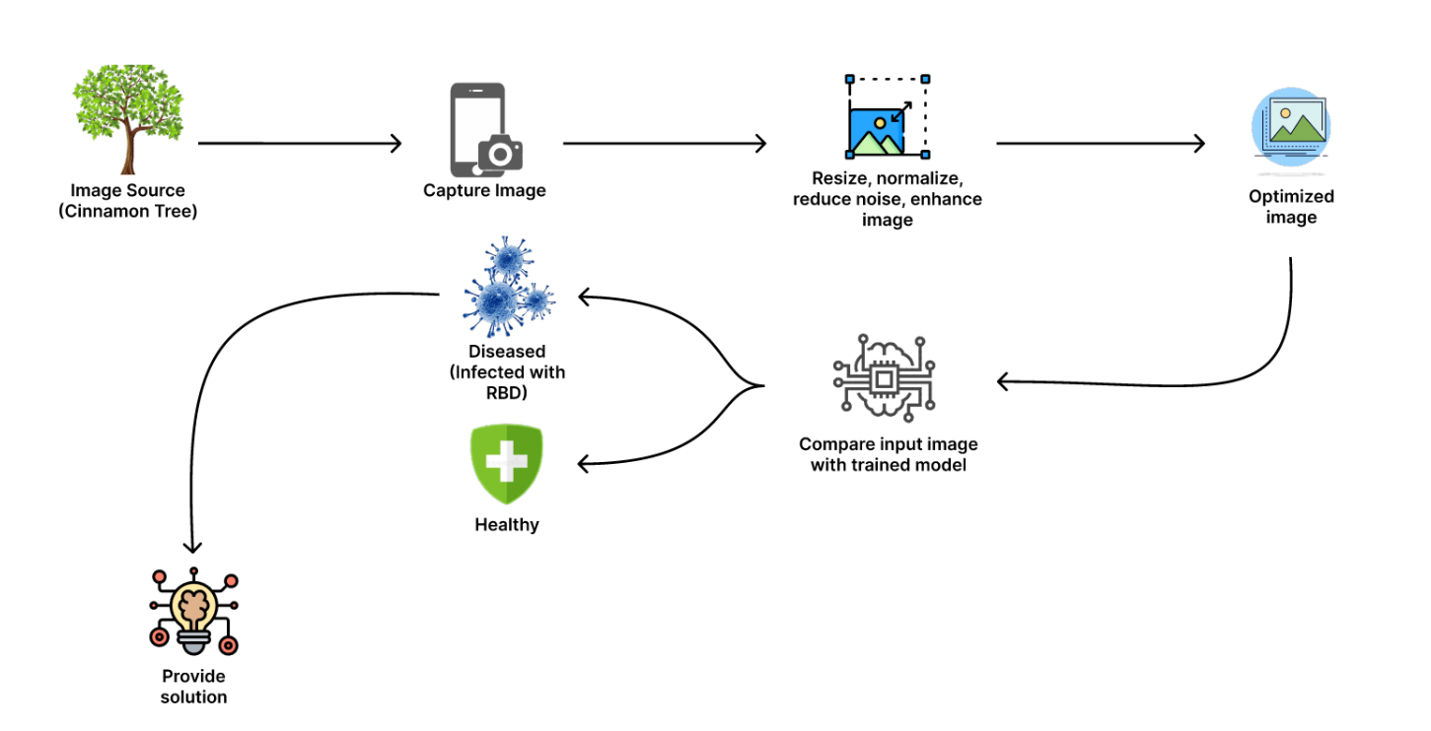
System overview
IT20252304 | EDIRISINGHE B.M | TMP-23-156

Slide 21
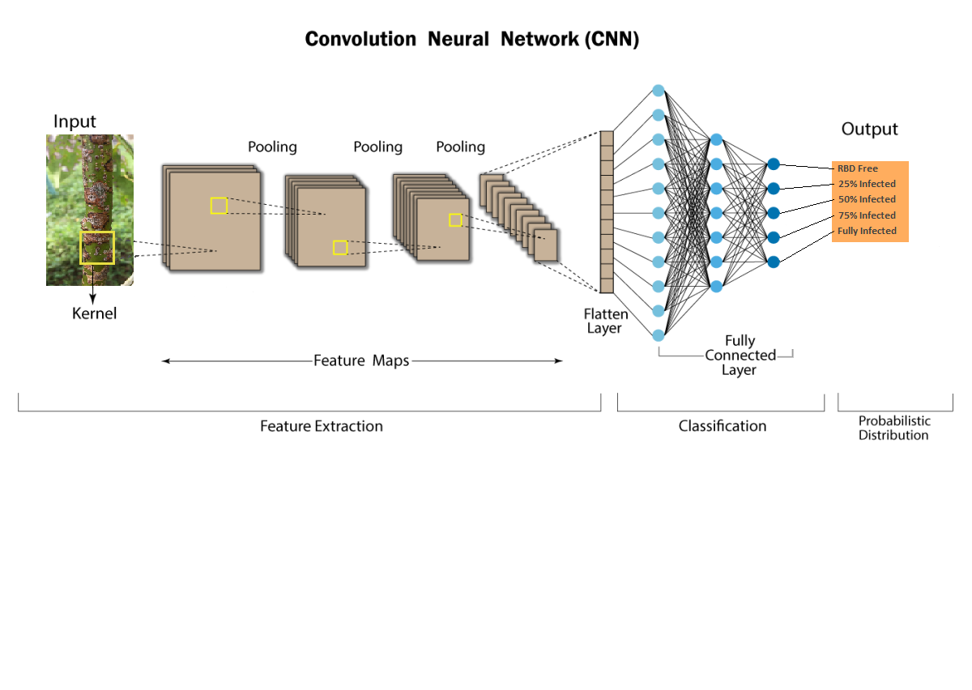
process
IT20252304 | EDIRISINGHE B.M | TMP-23-156

Slide 22
DATA SETS
Existing Rough Bark Disease Data Source: https://www.kaggle.com/datasets/madhavipethangoda/cinnamon-plant-stem-and-branch-disease-dataset (dataset published on kaggale.com)
IN
ADDITION
From National Cinnamon Research and Training Center(NCRTC) at Thihagoda.
IT20252304 | EDIRISINGHE B.M | TMP-23-156

Slide 23
REFERENCES
[1] D. L. C. Kumari Fonseka, H. N. Aluthgamage, and W. W. U. I. Wickramaarachchi, “Present situation of cinnamon industry in southern Sri Lanka,” International Journal of Current Research in Biosciences and Plant Biology, vol. 5, no. 8, pp. 63–70, 2018.
[2] “Cinnamon,” Cinnamon | Diseases and Pests, Description, Uses, Propagation. [Online]. Available: https://plantvillage.psu.edu/topics/cinnamon/infos. [Accessed: 05-Apr-2023].
[3] “Rough bark disease on cinnamon (cinnamomum zeylanicum): Disease ...” [Online]. Available: https://www.researchgate.net/publication/315380426_ROUGH_BARK_DISEASE_ON_CINNAMON_Cinnamomum_zeylanicum_DISEASE_SYMPTOMS_DEVELOPMENT_AND_THE_CAUSAL_AGENT_WITH_SPECIAL_REFERENCE_TO_ITS_MORPHOLOGY_HISTOPATHOLOGY_AND_NUTRITIONAL_STATUTES_OF_AFFECTED_PLAN. [Accessed: 05-Apr-2023].
[4] Author links open overlay panelAditya Sinha a, a, b, and AbstractThe olive tree is a highly beneficial fruit tree with the earliest known history of its plantation going back to 6000 years. The production of olive oil is facing a significant threat nowadays due to climate change and the spread of diseases. In t, “Olive spot disease detection and classification using analysis of leaf image textures,” Procedia Computer Science, 16-Apr-2020. [Online]. Available: https://www.sciencedirect.com/science/article/pii/S1877050920307511. [Accessed: 05-Apr-2023].
[5] Azad, R., Kumara, K.W., Senanayake, G., Ranawaka, R., Pushpakumara, D. and Geekiyanage, S., 2019. Intensity of leaf spot and rough bark diseases in cinnamon accessions collected from major cinnamon growing areas of Sri Lanka. Journal of the National Science Foundation of Sri Lanka, 47(3), pp.297–305. DOI: http://doi.org/10.4038/jnsfsr.v47i3.9403
‌
IT20252304 | EDIRISINGHE B.M | TMP-23-156

Slide 24
Over to Ekanayaka E.M.A.I.B.

Slide 25
Identify the quality of the harvest
Ekanayaka E.M.A.I.B
IT20252786
IT20252786 | Ekanayaka E.M.A.I.B | TMP-23-156

Slide 26

Challenges Faced by Cinnamon cultivators
Lack of knowledge about cinnamon quality hierarchy
Selling crops at a loss due to lack of knowledge
Undervaluing the product due to unawareness of specific grade
Exploitation of growers' lack of knowledge by middlemen
Manipulation of prices by middlemen
IT20252786 | Ekanayaka E.M.A.I.B | TMP-23-156

Slide 27
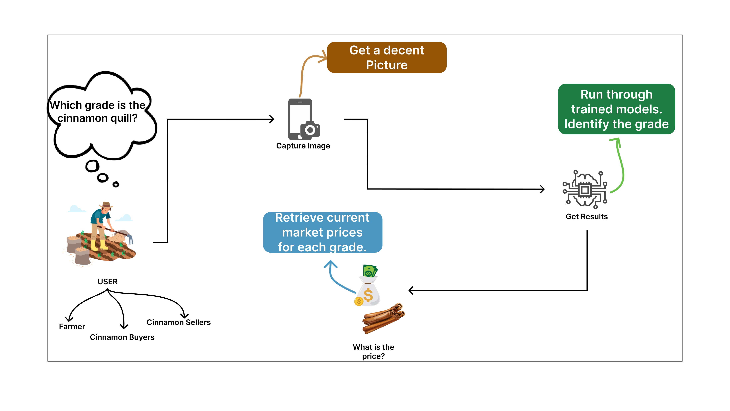
SOLUTION
IT20252786 | Ekanayaka E.M.A.I.B | TMP-23-156

Slide 28
Cinnamon Grades In The Market And The Difference
Grade | Characteristics
Alba | Thin, tightly rolled quills with a light color. Delicate aroma. Highest quality grade.
C5 Special | Slightly thicker quills than Alba grade. Well-rolled and may have a slightly darker color.
C5 | Reasonably good quality. Quills are thicker and less uniform compared to the higher grades. Darker color and may include some broken pieces.
C4 | Thicker and coarser quills. Darker color and may have a stronger aroma and flavor.
M5 | Mix of good and medium quality. May include a combination of thinner and thicker quills, resulting in variations in appearance, aroma, and flavor.
H1 and H2 | Thicker and coarser quills. Darker color. Aroma is not as strong as M5.
Cinnamon Quillings - No 1 | Broken or smaller pieces of cinnamon bark that are not suitable for whole quills. No 1 generally represents larger or higher quality pieces.
Cinnamon quillings - No 2 | Broken or smaller pieces of cinnamon bark that are not suitable for whole quills. No 2 generally represents smaller or lower quality pieces.
IT20252786 | Ekanayaka E.M.A.I.B | TMP-23-156

Slide 29
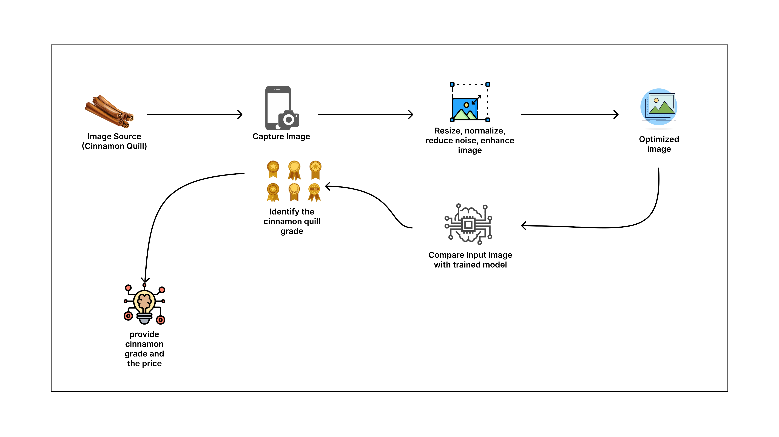
System overview
IT20252786 | Ekanayaka E.M.A.I.B | TMP-23-156

Slide 30
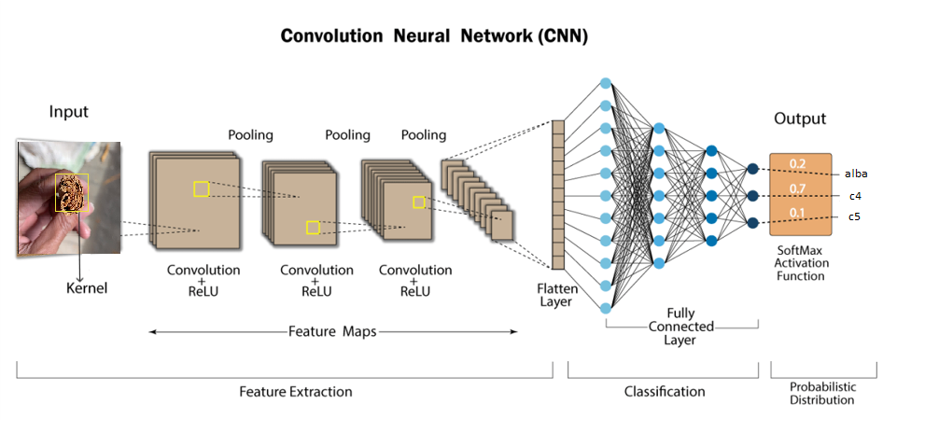
Technologies
IT20252786 | Ekanayaka E.M.A.I.B | TMP-23-156

Slide 31
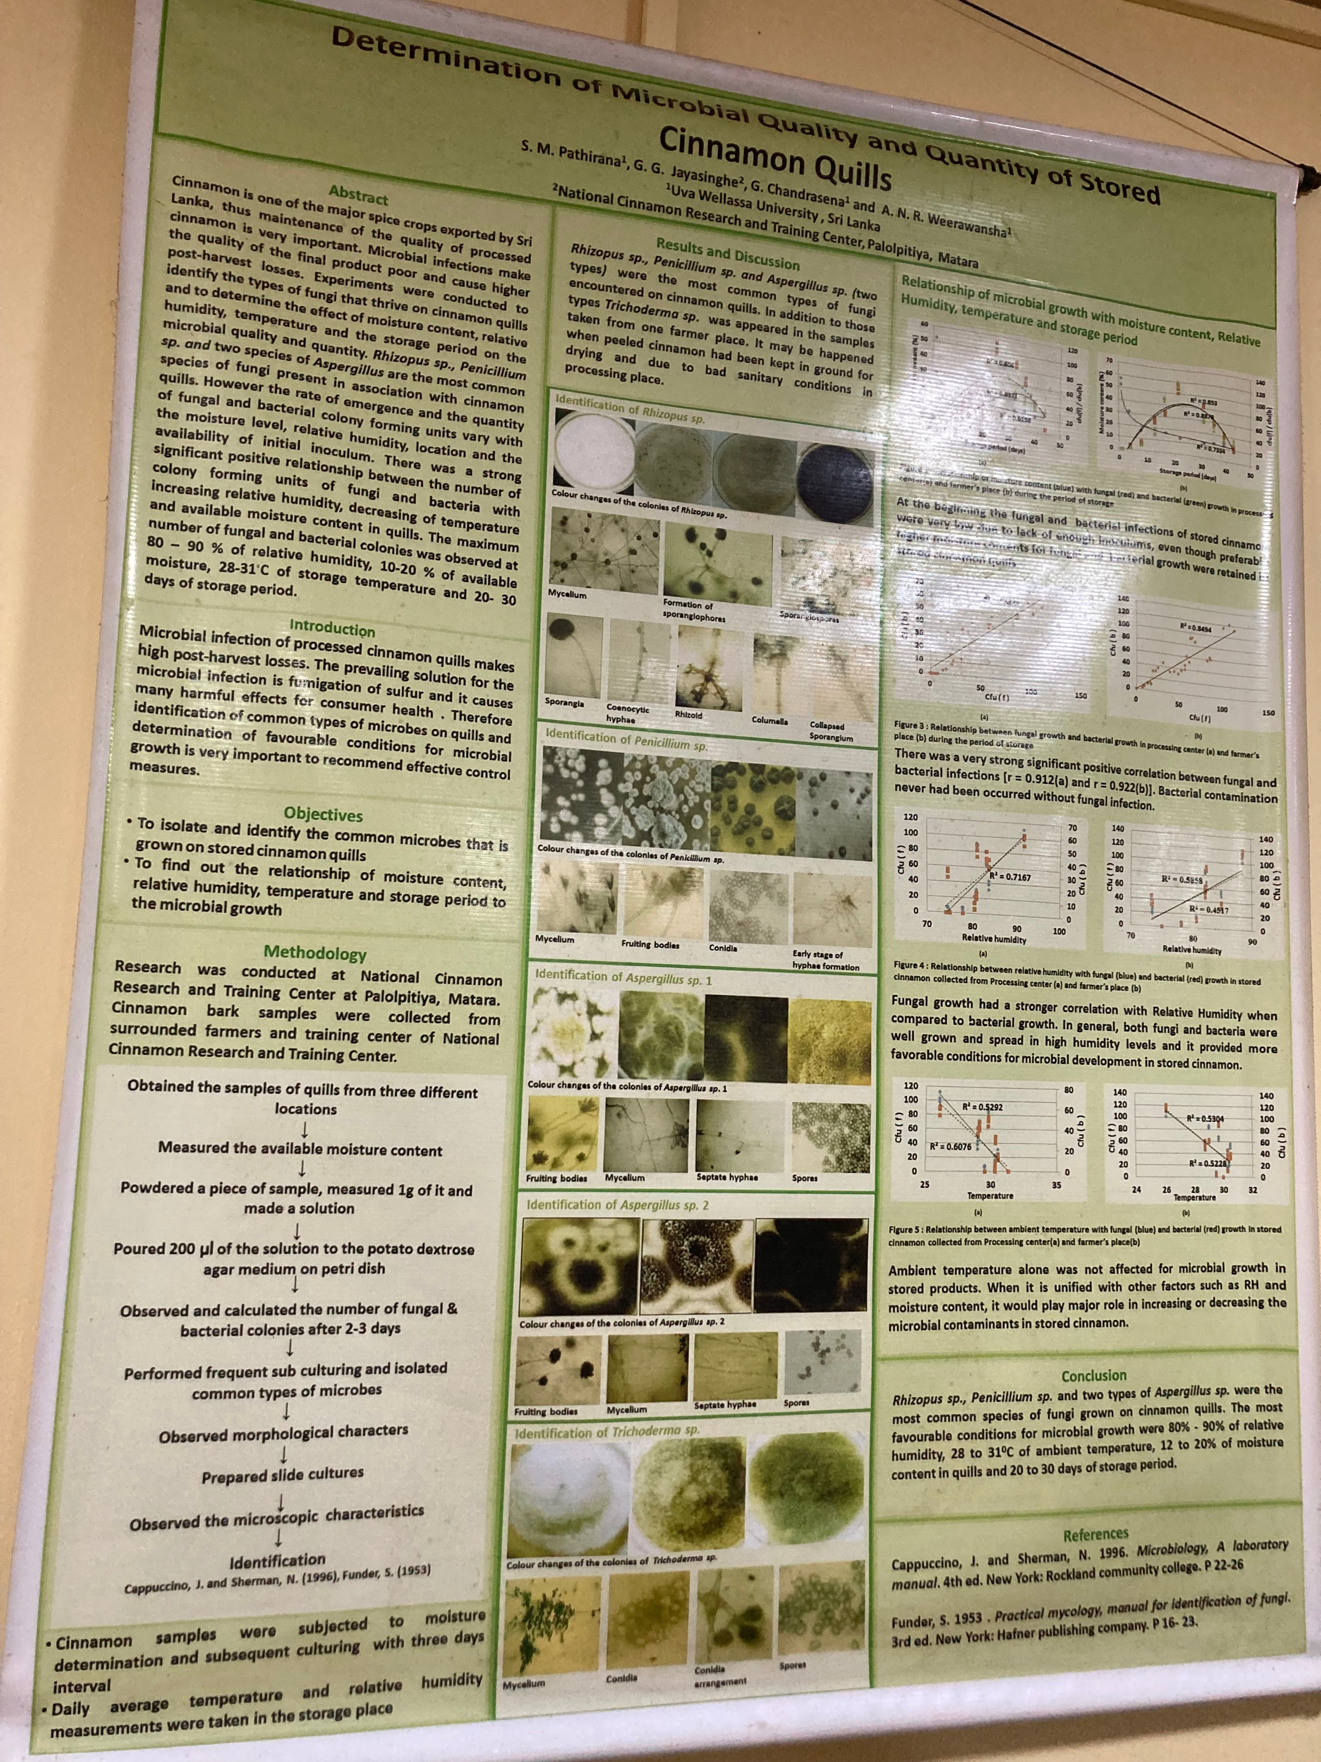
Thihagoda research center (poster about cinnamon quality)
IT20252786 | Ekanayaka E.M.A.I.B | TMP-23-156

Slide 32
Research Gap
Existing related research
Detecting the cinnamon quill
[1] K. W. a. B. S. .P. Jayasuriya, "IoT based Cinnamon Quality Control Systemthrough Image Processing," Research gate,2018.
[2]N. M. N. M. M. T. D. N. K. A. Malini T1, "Testing the quality of cereals and pulses using LabVIEW," 2021.
Identifying the cinnamon quill grade
[1] K. W. a. B. S. .P. Jayasuriya, "IoT based Cinnamon Quality Control Systemthrough Image Processing," Research gate,2018.
Research Gap
Lack of research on technical solutions for grading the cinnamon quill
Our Research
Provides a mobile application that can detect and provide grades for Ceylon Cinnamon
Provide the Current market price for identified grade
The system is optimized so that it responds accurately to lower-quality images and memory
IT20252786 | Ekanayaka E.M.A.I.B | TMP-23-156

Slide 33
References
[1] K. W. a. B. S. .P. Jayasuriya, "IoT based Cinnamon Quality Control Systemthrough Image Processing," Research gate,2018.
[2]N. M. N. M. M. T. D. N. K. A. Malini T1, "Testing the quality of cereals and pulses using LabVIEW," 2021.
[3] V. S. K. a. B. N. Shaikh:, "Identification And Quality Testing Of Rice Grains Using Image Processing And Neural network," 2017.
[4] G. M. A. C. Devraj Vishnu, "A computer vision approach for grade identification of rice bran," 2017.
[5] J. S. N. L. S. B. A. U. M. G. Manish Bhurtel1, "DEEP LEARNING BASED SEED QUALITY TESTER," 2019.
[6] A. P. R. Shivpriya Desai, "Seed Quality Analysis Using Image Processing and ANN," 2017.
IT20252786 | Ekanayaka E.M.A.I.B | TMP-23-156

Slide 34
DATA SETS
Gathered a data set during an on-site visit to the Thihagoda Cinnamon Research facility.
IT20252786 | Ekanayaka E.M.A.I.B | TMP-23-156

Slide 35
Over to Gamaethige G.G.S.A.

Slide 36
CINNAMON Farmer support community.
Gamaethige G.G.S.A.
IT16026476

Slide 37

Problem
Lack of knowledge transfer among farmers.
Communication gaps among veterans and beginners.
Technological barriers.
Not many reliable resources.
No interactive platforms to ask questions.

Slide 38
SOLUTION
User encounters the problem
User tries getting a solution by asking around
User submits the question to Smart Assistant
Smart Assistant returns the answer
YES
Smart Assistant searches the Knowledge Base
Smart Assistant understands the question
NO
Other users answer the question on Forum
Smart Assistant publishes the question on Forum
Semantic Analysis

Slide 39
INPUTS
User specific questions will be consumed by the Smart Assistant.
A question should have meaningful values for following attributes.
Type : To categorize questions based on the nature of the question
Title
Description
Tags : To make searching the existing knowledge base faster

Slide 40
RESEARCH GAP
There are current research on User Feedback Analysis using Sentimental Analysis
However, there is no targeted solution introduced to understand cinnamon industry related questions.
Statistical Semantic Parsers are more accurate but Rule-based Semantic Parsers allow to enable custom rules.
Challenge is to find a compromise between them.

Slide 41
REFERENCES
[1] Baddegamage, S. I. (2014, April). ICT in Sri Lankan cinnamon industry: Impact of language barriers and digital divide. In 2014 International Conference on Electrical Engineering and Information & Communication Technology (ICEEICT) (pp. 1-6). IEEE.
[2] Aung, K. Z., & Myo, N. N. (2017, May). Sentiment analysis of students’ comment using lexicon based approach. In 2017 IEEE/ACIS 16th International Conference on Computer and Information Science (ICIS) (pp. 149-154). IEEE.
[3] Wiratama, G. P., & Rusli, A. (2019, October). Sentiment analysis of application user feedback in Bahasa Indonesia using multinomial naive Bayes. In 2019 5th International Conference on New Media Studies (CONMEDIA) (pp. 223-227). IEEE. doi: 10.1109/conmedia46929.2019.8981850
[4] Sales, J. E., Freitas, A., & Handschuh, S. (2018, January). An open vocabulary semantic parser for end-user programming using natural language. In 2018 IEEE 12th International Conference on Semantic Computing (ICSC) (pp. 1-8). IEEE. doi:10.1109/ICSC.2018.00020

Slide 42
Thank You!

